Slide 2
Education

Slide 3
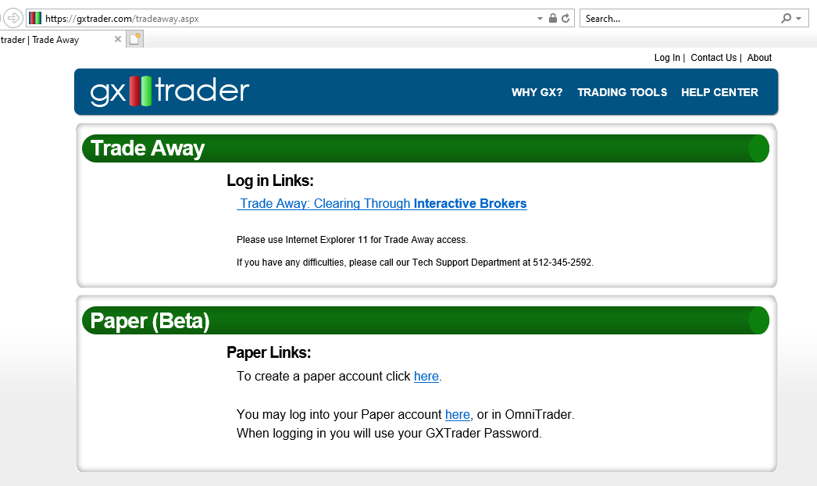
GXTrader Paper Broker
If you have a GXTrader account, you can create up to 10 paper broker accounts to practice trading.
https://gxtrader.com/tradeaway.aspx
Open Internet Explorer and visit https://gxtrader.com/tradeawaypaper/ to create paper accounts.
*Tradeaway uses MS Silverlight so you have to use Internet Explorer.

Slide 4
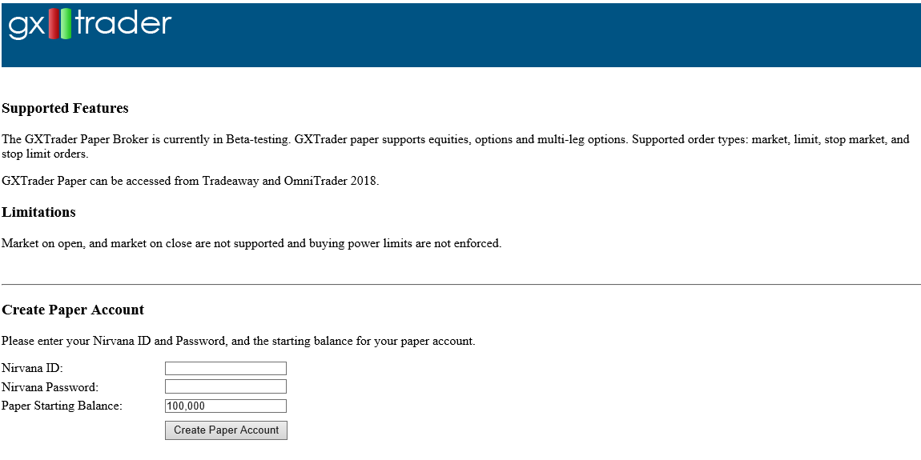
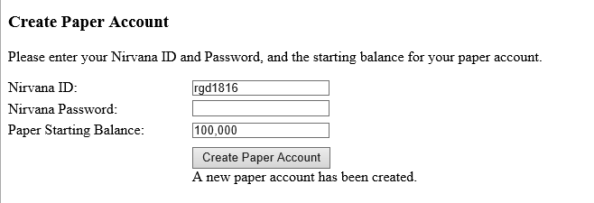
GXTrader Paper Broker
Login to create the paper accounts using your Nirvana credentials.

Slide 5
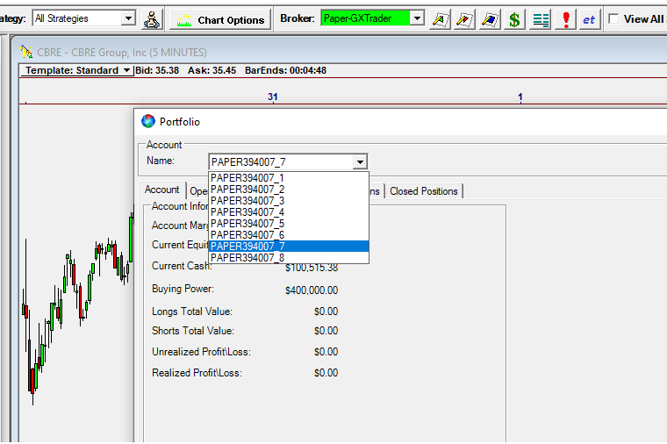
GXTrader Paper Broker
Login to the paper broker using your GXT credentials.
Click the broker icon in OmniTrader or the Accounts button in VisualTrader to switch between accounts.

